Slide 1
CS6359 - Object-Oriented Analysis and Design
Cyberminer Project Team Members
Rainam Shah (rjs190010)
Dhyani Gandhi (dpg190001)
Dharav Bhatt (dnb210000)
Abhijeetsinh Vaghela (abv210000)
Chenyue Li (cxl190051)
Rutvik Avaiya (rxa210000)
Yash Majmudar (ynm210000)
Poojitha Bijjam (pxb190029)
Akash Karuturi (axk200169)
Rohith Jallipalli (rxj200037)
Yasaswi Devi Tiyyagura (yxt200010)
Pavan Sai Pabbisetty (pxp210011)
Yang Yang (yxy110930)

Slide 2
Team Distribution
Team | Members | Team Leader
Frontend Team | Rainam Shah Dhyani Gandhi AbhijeetSinh Vaghela Chenyue Li | Rainam Shah
Backend Team | Poojitha Bijjam Akash Karuturi Rohith Jallipalli Pavan Pabbisetty Yasaswi Devi Tiyyagura | Poojitha Bijjam
UML and Documentation Team | Dharav Bhatt Rutvik Avaiya Yash Majmudar Yang Yang | Dharav Bhatt

Slide 3
What is Cyberminer?
Cyberminer is a search engine that accepts input and displays list of URLs, whose description or title matches to the input entered.
It takes list of keywords through textbox in the user interface.
In output, it displays the list of URLs, titles and descriptions.

Slide 4
Functional Requirements
When the user clicks on the URL, which has been retrieved as the result of a query, the system takes the user to the corresponding website.
Multiple Search Engines work concurrently and shows the respective results.
The system shall allow the user to specify the mode of search, using “OR”, “AND” or “NOT”.

Slide 5
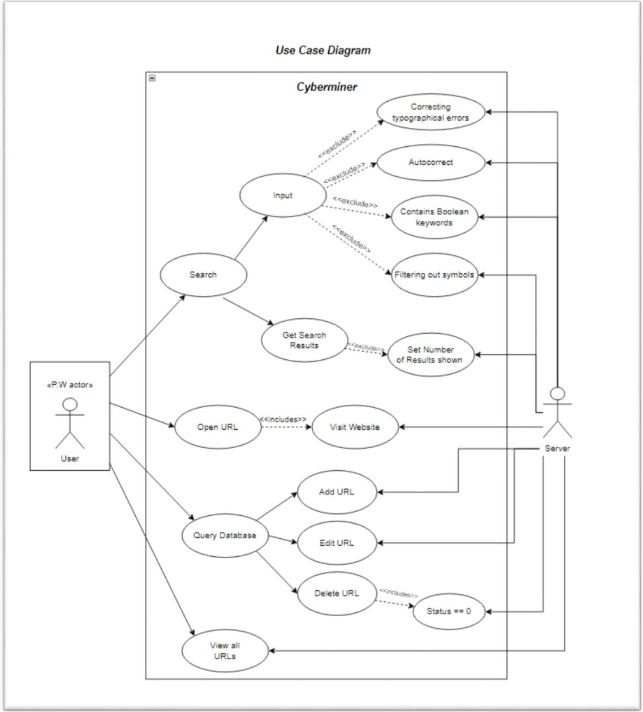
Use Case Diagram

Slide 6
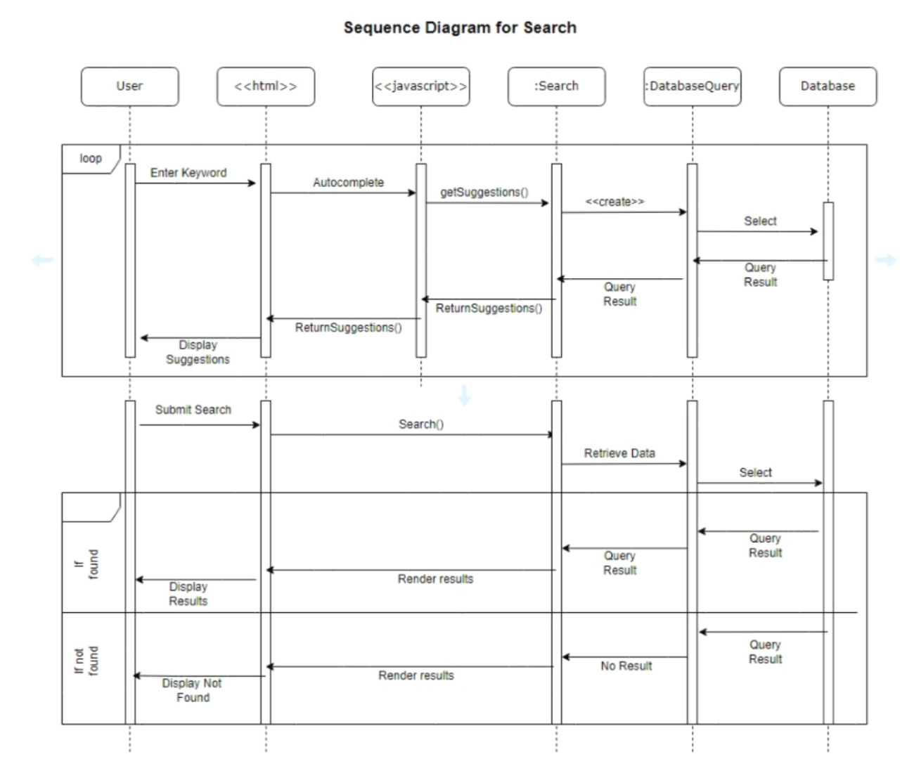
Sequence Diagram

Slide 7
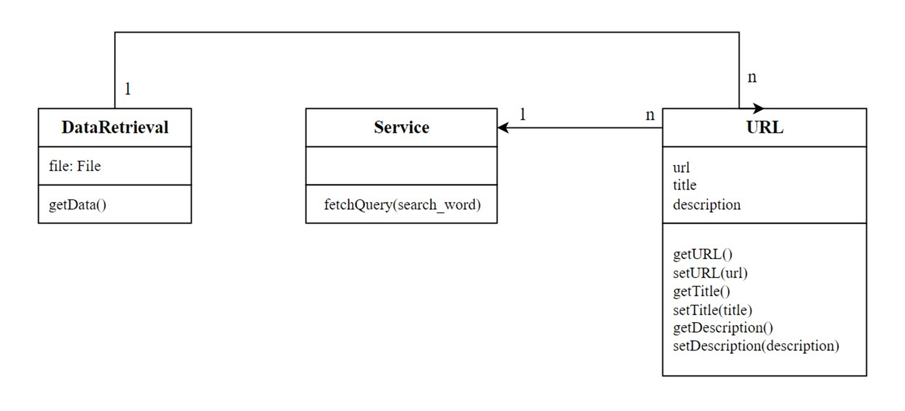
Class Diagram

Slide 8
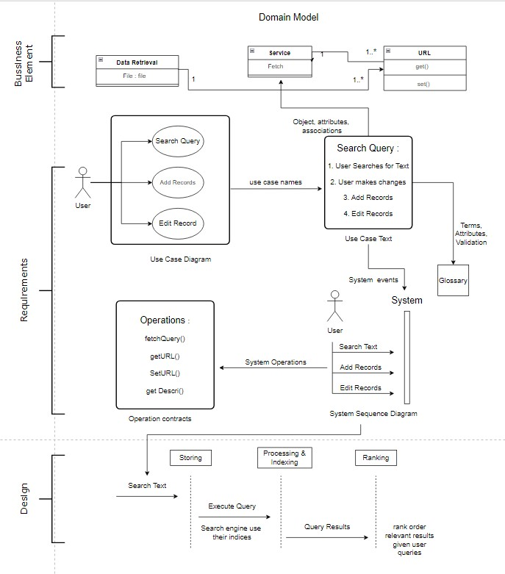
Road-Map Diagram

Slide 9
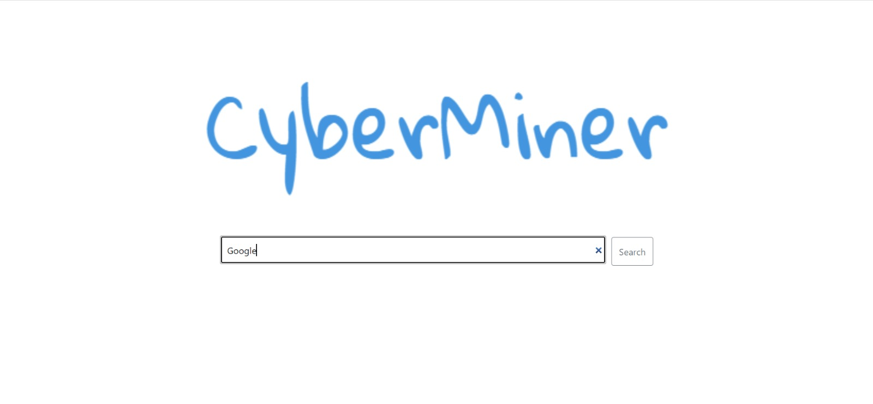
Front-end Implementation
We have used React as the front-end framework.
In the initial phase, we have developed home page and a page that shows URLs as results according to search string.

Slide 10
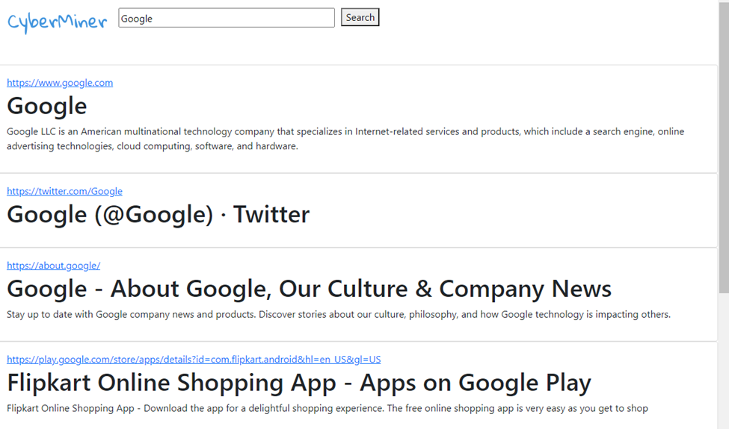
Front-end Implementation

Slide 11
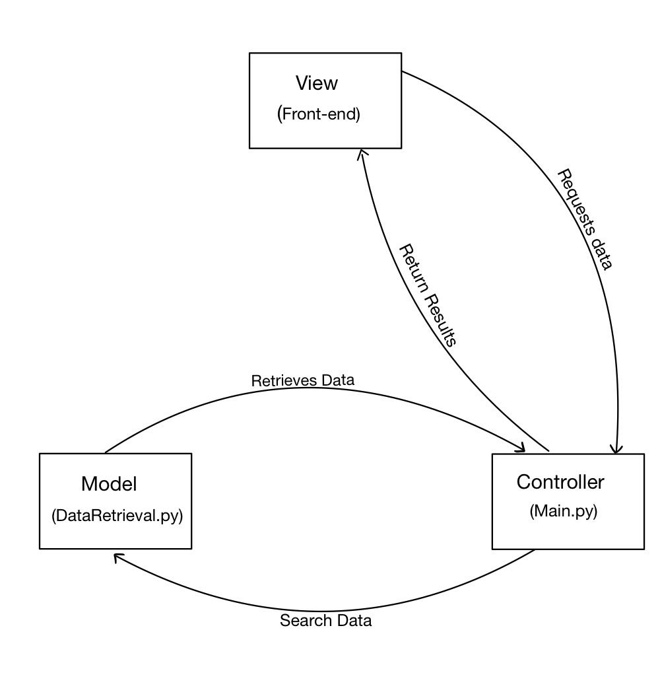
Back-end Implementation

Slide 12
Integration
Axios({
method: "POST",
data: { searchInput: this.state.searchInput },
url: "http://localhost:5000/searchWord"}).then((res) => {
this.setState({
searchResults: res.data["result"],
});
});

Slide 13
Output
[{
'title': 'Cricbuzz',
'url': ' https://www.cricbuzz.com ',
'description': 'Cricbuzz is an Indian cricket news website owned by Times Internet. It features, news, articles and live coverage of cricket matches including videos, text commentary, player stats and team rankings-Google. '
}]

Slide 14

Demo

Slide 15
Future Work
Move from csv file to database.
Add binary search option.
Add option for user to enter numbers of results needed.
Add Suggestions and Autocomplete features.
Cache the data for quick response to search.
Update UI to provide users with option to add and edit URLs in the database.
Add more URLs to increase number of search results.

Slide 16
Thank You
Any Questions ?

